Slide 1
Credit Policy – IDIDI Bank
By Mayank Shah
Jigsaw Academy

Slide 2
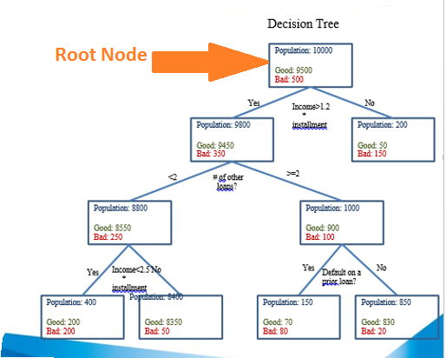
Decision Tree
The Decision Tree was performed on
the Population of 10000 customers.
Amongst these customers 9500 are
Non-Defaulter i.e. Good Customers
and 500 are Defaulters i.e. Bad Customer.
The Root node with 10000 customers
Are further splitted Based on attributes
like Good,Bad,default on prior
Loan,Income.
Parent Node has :5% of Default Rate and 95%
Non-default rate.

Slide 3
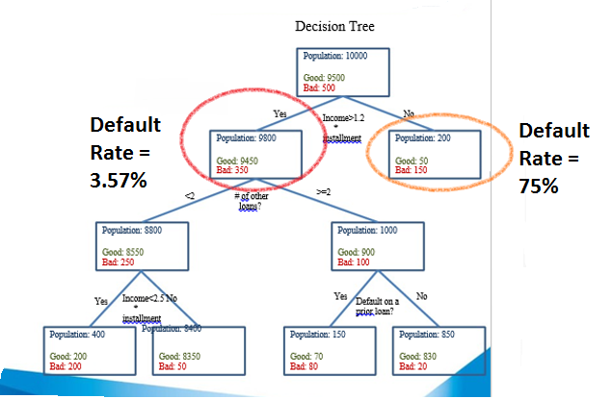
Node-Income > 1.2 * Installment Attribute
Based on the attribute :Income>1.2*Installment
the population is splitted into 2 nodes.
If Income is >1.2*Installment than the Rate of
Default reduces to 3.57% from 5%.
If Income is <1.2*Installment than the Rate of
Default increases from 5% to 75%.
So, loans should only be provided to customers
with Income > 1.2 * Installments.

Slide 4
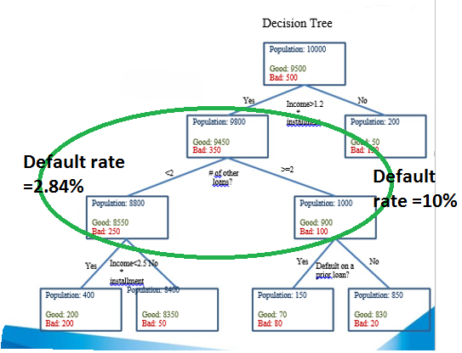
Income>1.2*Installment & # of Loans < or >2
If Income>1.2 * Installment and Number of other loans are < 2
than the default rate further reduces to 2.84% from 3.57%.
On other hand if Income >1.2*Installment but Number
of loans are >=2 than the default rate increases to 10% from 3.57%.
So Business rules can be made that loans will be provided
only if Income>1.2*Installment and # of loans < 2.

Slide 5
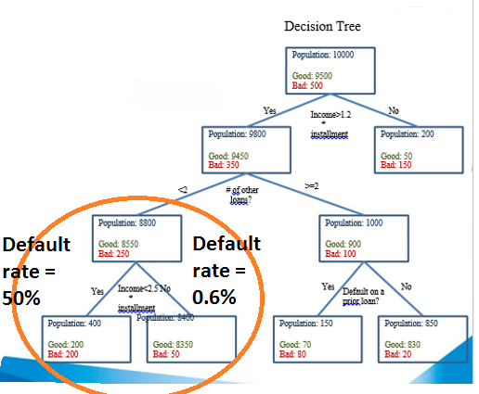
Income >2.5 * Installments and #of loans<2
If Income > 1.2 * Installment and < 2.5 * Installment
and number of loans < 2 then the default rate increases
to 50%.
On other hand if Income > 2.5 * Installment
and number of loans < 2 then the default rate
Decreases to 0.6%.
So another rule can be made that to provide a
loan the income should be >2.5 * Installments and
No. of loans be <2.

Slide 6
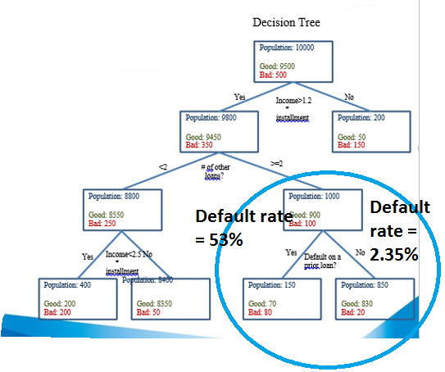
Defaulted on Prior Loan and has >=2 loans
With Nos. of loans >=2 the default rate is 10%
Provided that the income >1.2*Installments and
along with it if the customer had defaulted
On some prior loan then this default rate will
Reach upto 53%.
And if nos. of loans >=2 with income > 1.2*installments
and if the customer has not defaulted on any prior loan
This default rate drastically reduces to 2% from 10%.
So rule can be made that if a customer has >=2 loans,
Has defaulted on any prior loan with income
>1.2 * Installments only than he or she may not be sanctioned
Loan.

Slide 7
Business Rules for Credit Policy-IDIDI Bank
Based on the analysis and reviewing decision tree following are the insights :
Don’t sanction a loan to people whose income is < 1.2 * Installment.

Slide 8
Business Rules for Credit Policy-IDIDI Bank
Don’t sanction a loan to someone whose Income is >1.2 *Installments but has >= 2 number of loans and has defaulted on some prior loan.
But people who have not defaulted on any prior loan and even if he/she has >=2 loans and income>1.2*Installment can be sanctioned loan.
If Income > 1.2 * Installment and < 2.5 * Installment and number of loans < 2 then do not sanction loan.
Whereas if Income > 2.5 * Installment and number of loans < 2 then loan can be sanctioned.

Slide 9
Thank You

